Slide 1

Student Organization System (SOS)
Armando J. Ochoa – Primary Facilitator
Yovanni Jones – Developer
Anthony Sanchez-Ayra – Team Leader
Teriq Douglas – Minute Taker
M.Kian Maroofi – Time Keeper
Date: 10/01/2019

Slide 2
Purpose and Scope of System
Provide a single point of access to all users to
Check all the organizations they belong to.
Find nearby events hosted by organizations.
Discover new organizations.
Connect with other members.
Manage organization leaders and their privileges.
Create and advertise organization-related events.
Out of Scope:
Social Media Features
Organization finance management.

Slide 3
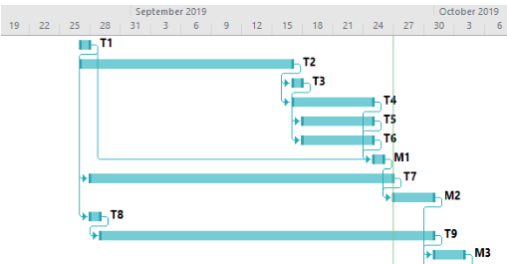
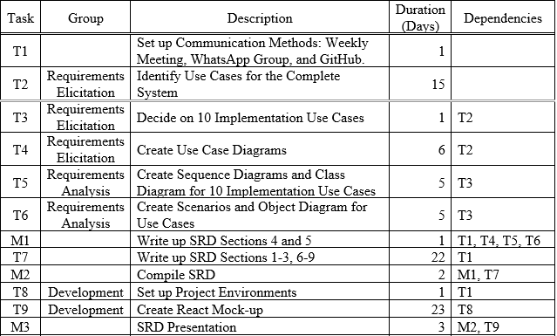
Project Schedule
Gantt chart for the first deliverable.
Scheduled tasks up to the first deliverable.

Slide 4
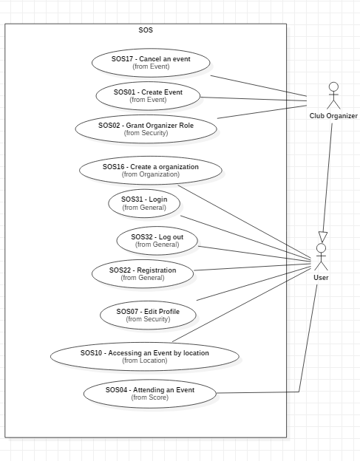
UML Use Case Diagram

Slide 5
SOS16 Create Organization Functional Requirements
Preconditions - user is logged in.
Description:
User clicks on “Organization Tab.”
The webpage switches to Organization page.
User click on “Create Organization.”
User then fills out form asking for the Organization details.
User submits form to the Organization page.
Postconditions – user becomes Club Organizer for the Organization.

Slide 6
SOS16 Create Organization Nonfunctional Requirements
Usability:
2 minutes to complete the request.
Reliability:
Mean time to failure – 5% monthly.
Performance:
200 requests per min and process each in 6 sec.
Criticality:
High. Main purpose of the system.
Frequency:
20 organization requests monthly.
Notes:
Risk to implement is medium since it requires web-based technology.

Slide 7
SOS07 Edit Profile Functional Requirements
Preconditions:
User is logged in.
Description:
User clicks “Edit Profile.”
User is shown an editable form.
User inputs the data and submits the request.
The webpage request the user’s password.
System authenticates their request.
Postconditions:
User data has been updated on the data storage.

Slide 8
SOS07 Edit Profile Nonfunctional Requirements
Usability
20 sec to find and complete use case.
Reliability
Mean Time to Failure – 5% monthly.
Performance
20 checks per min and process each ~2 sec.
Criticality
Low. Secondary feature of the system.
Frequency:
20 profile edits per week.

Slide 9
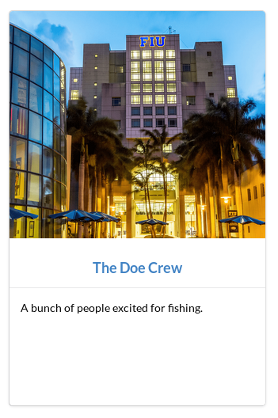
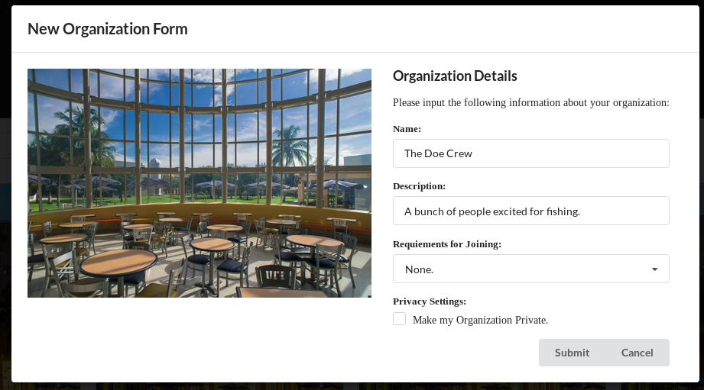
User Interface Design for SOS16
New Organization Form for SOS16 Scenario
Resulting Organization

Slide 10
User Interface Design SOS16
New Organization Form for SOS16 Scenario
Resulting Organization

Slide 11
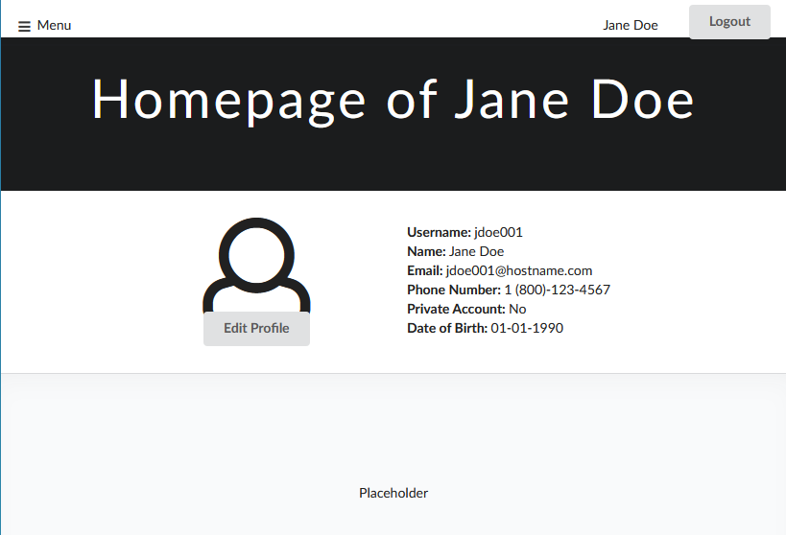
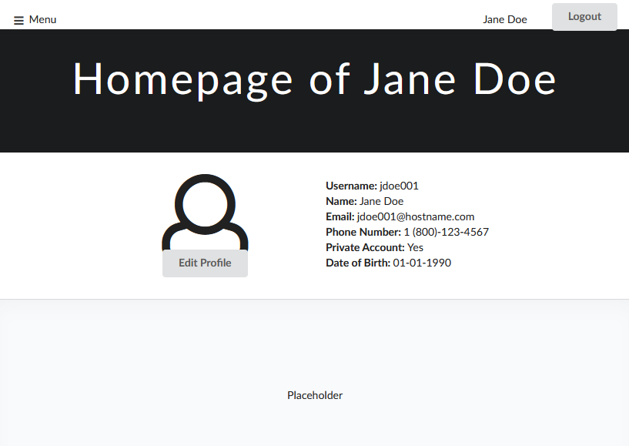
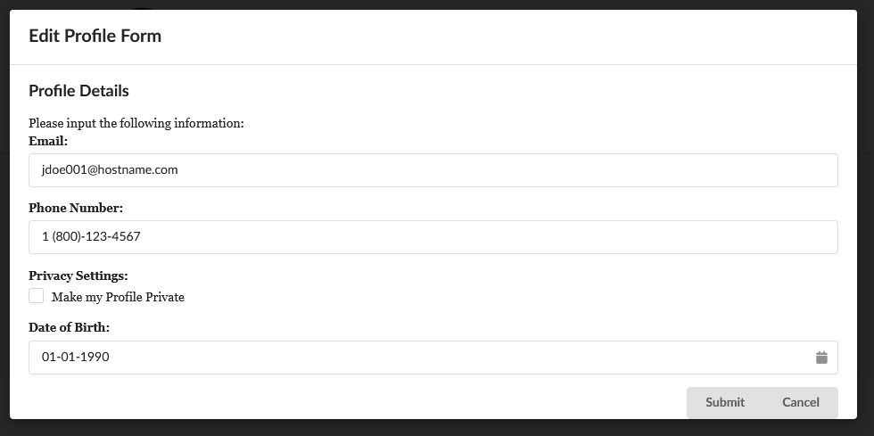
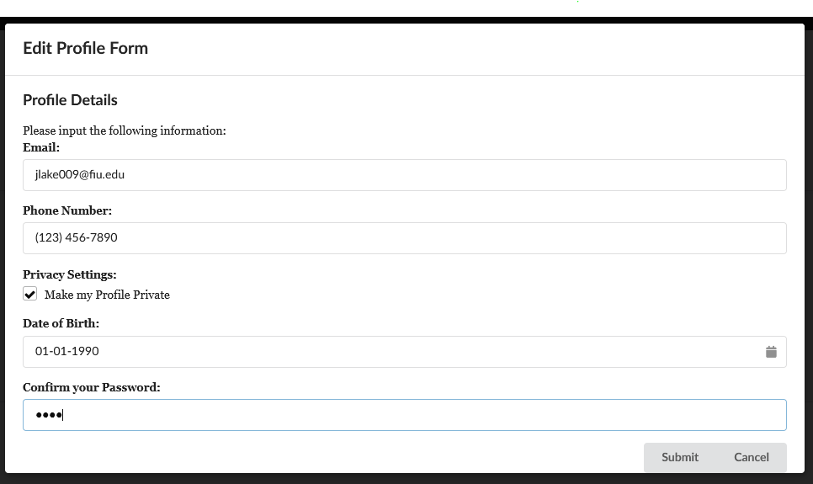
User Interface Design for SOS7
Homepage for User Jane Doe
Edit Profile Form

Slide 12
Requirement Analysis SOS16
SOS16
Identify Analysis Objects.
Object Diagram
Create Scenarios to represent instances of SOS.
Class Diagram
Create Classes and define relationships to solidify system schematics.
Sequence Diagram
Create functions to realize the functional requirements of SOS16

Slide 13
Requirement Analysis SOS07
Sequence Diagram
Class Diagram
Object Diagram
SOS07

Slide 14
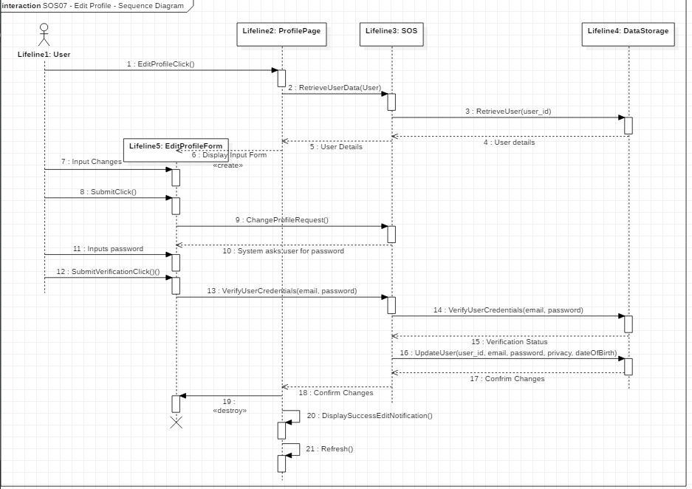
Sequence Diagram for SOS7

Slide 15
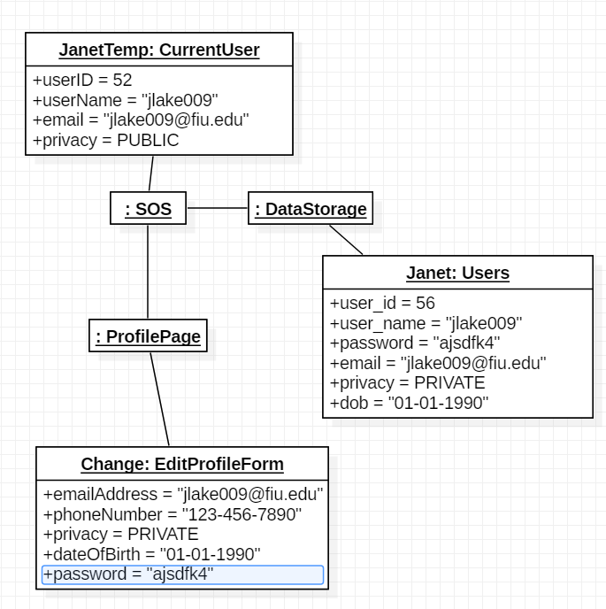
Object Diagram SOS16
Notes:
Change object diagram

Slide 16
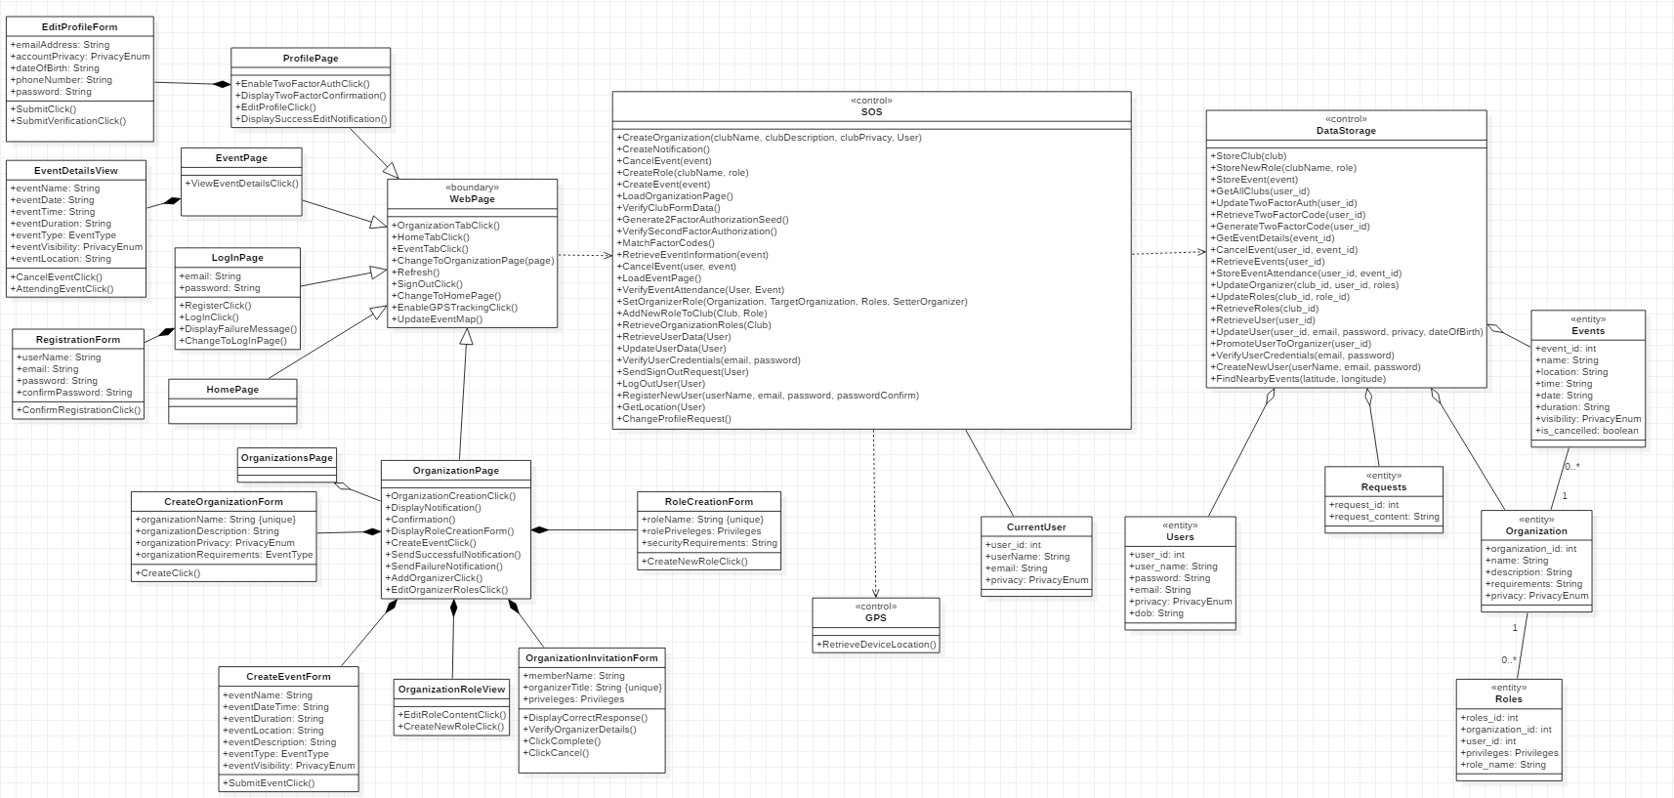
Class Diagram for SOS
Notes:
Change class diagram

